Slide 1
Final Capstone Project
IBM

Slide 2
Introduction
Car accidents are happending all the time in the world. According to WSDOT's (2017) data, a car accident occurs every 4 minutes and a person dies in a car crash every 20 hours in the state of Washington, U.S.A. To help with reduction of car accident cases, this project trys analysing the determinants of an accident and sheds light on predicting the severity with those factors.

Slide 3
Data Scource
The data of car accidents which have occurred within the city of Seattle, Washington from the year 2004 to 2020 was used. This data is regarding the severity of each car accidents along with the time and conditions under which each accident occurred.

Slide 4
Precedure
All useful features were extracted and and the missing values were handled at first, followed by a creation of a balanced dataset with equal number of two severity type cases. Lately classification methods such as KNN, random forest and decision tree were used.
The model used aims to predict the severity of an accident with other information provided. At last models were evaluated by accuracy scores

Slide 5
Data Processing
Feature extraction:
X & Y: variables were first renamed to LONGITUDE and LATITUDE for clarification.
OBJECTID, INCKEY, COLDETKEY, REPORTNO, INTKEY, EXCEPTRSNCODE, SDOT_COLCODE, SDOTCOLNUM, ST_COLCODE, ST_COLDESC, SEGLANEKEY & CROSSWALKKEY: were code-based were dropped as they are meaningless.
STATUS, EXCEPTRSNDESC, INCDATE, INCDTTM, SDOT_COLDESC, PEDROWNOTGRNT, ST_COLDESC, UNDERINFL, PEDCYLCOUNT, HITPARKEDCAR, SEVERITYDESC & ADDRTYPE: were dropped as they did not help for the analysis
SEVERITYCODE.1: were dropped as it is a duplicate of SEVERITYCODE

Slide 6
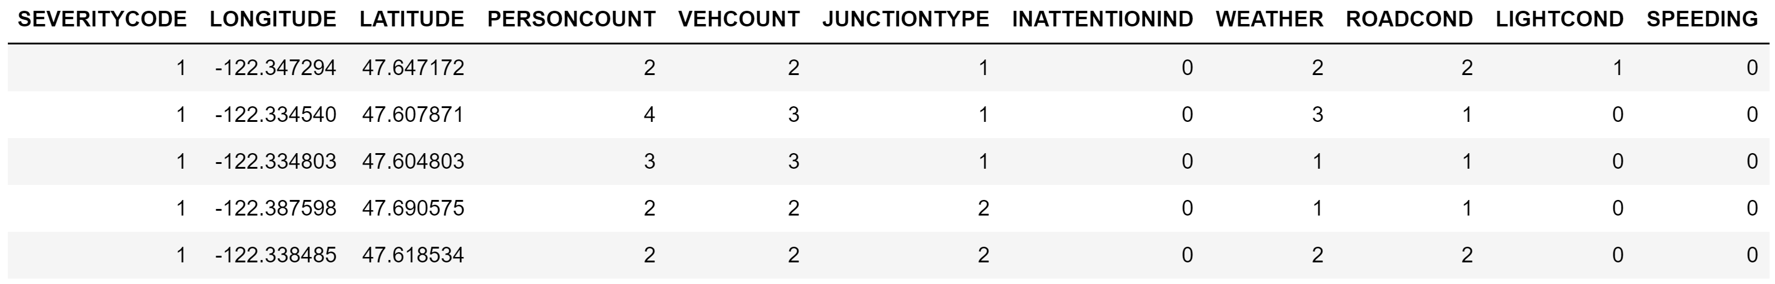
Dealing with missing values:
WEATHER: rows were dropped as weather is an important factor in car accidents, so we can’t simply fill in randomly chosen value. For LONGITUDES and LATITUDES: were filled by mean values.
SPEED & INATTENTIONIND: “N” (negative) were filled in.
Other factors such as LIGHT condition and ROAD condition, etc: “Unknown” were filled instead.
Final step:
Resampling and encoding categorical values

Slide 7
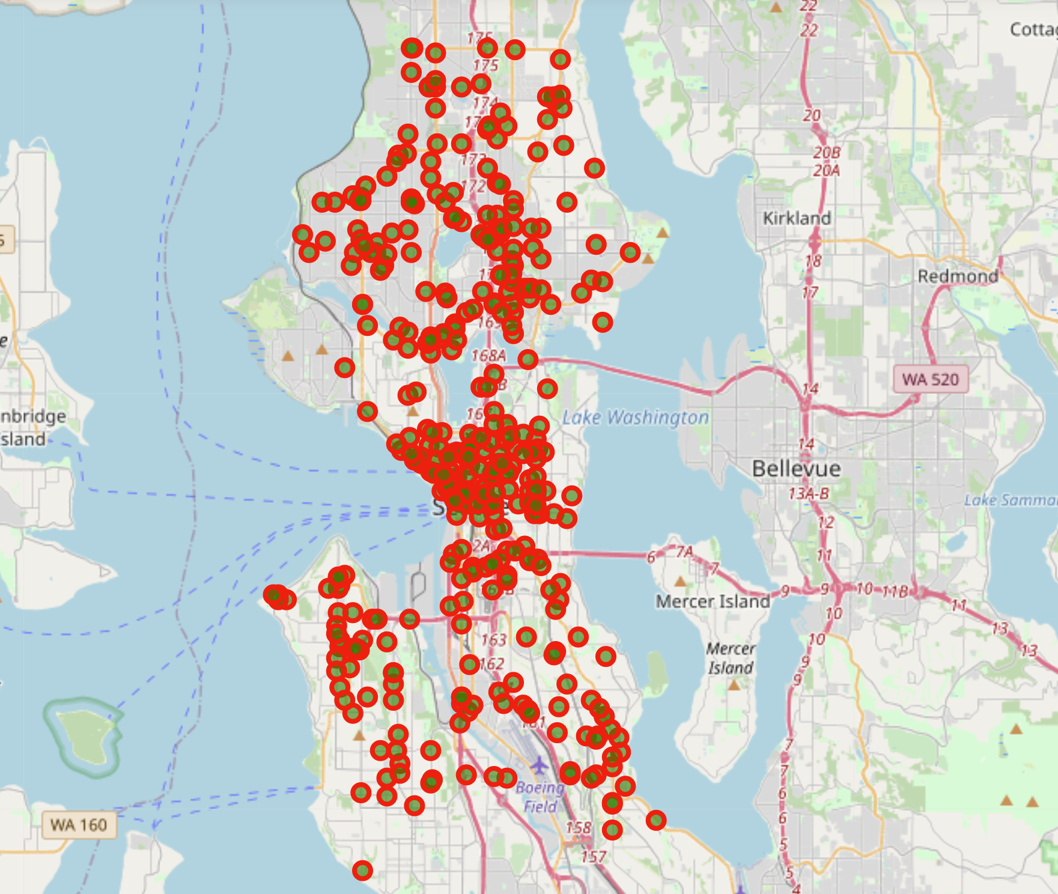
Exploratory data analysis
1. Mapping:

Slide 8
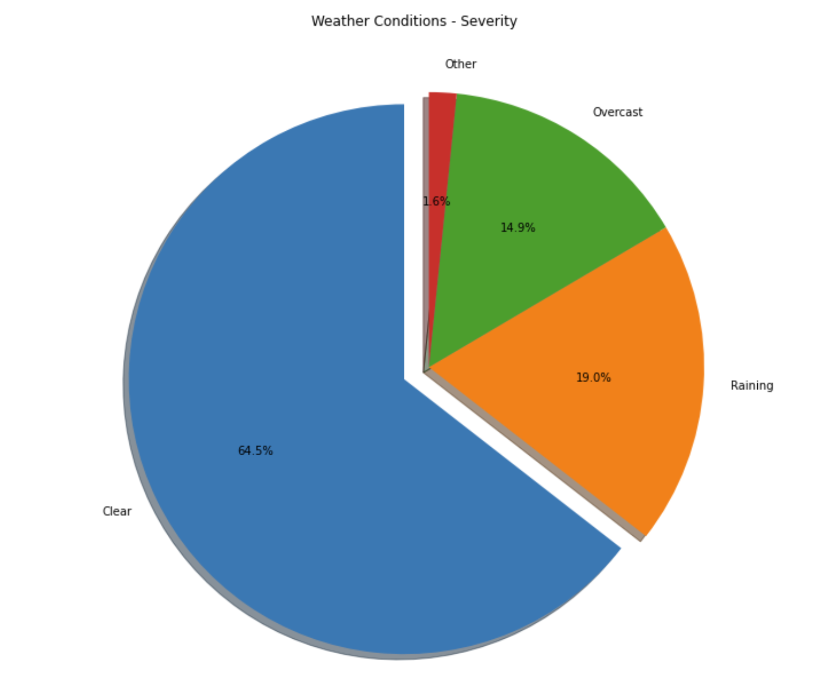
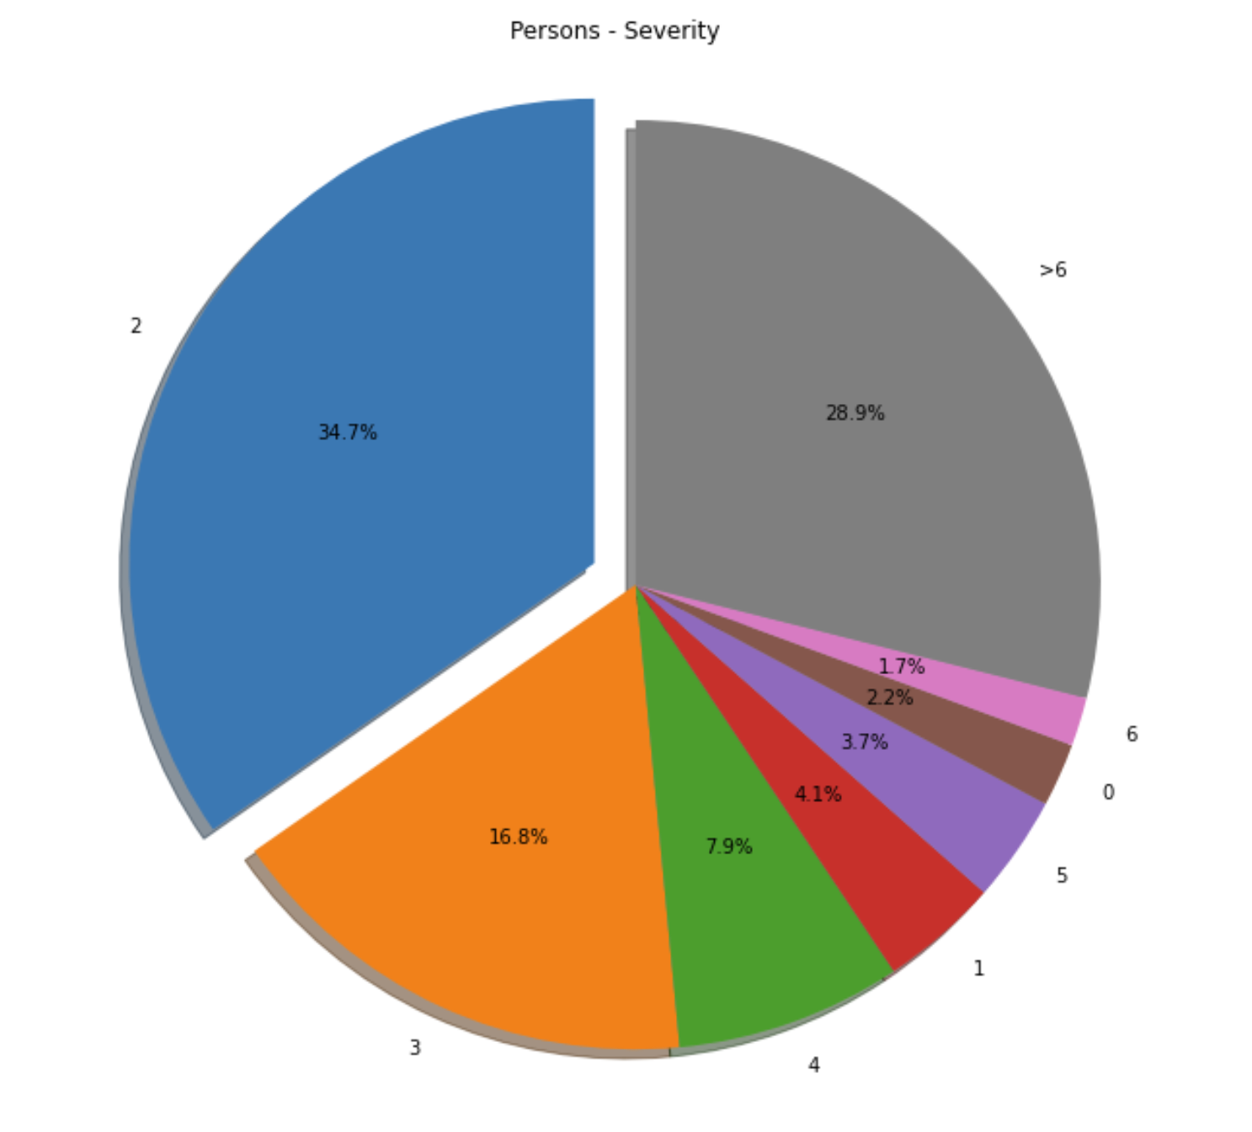
2. Visualizing in-feature types:

Slide 9
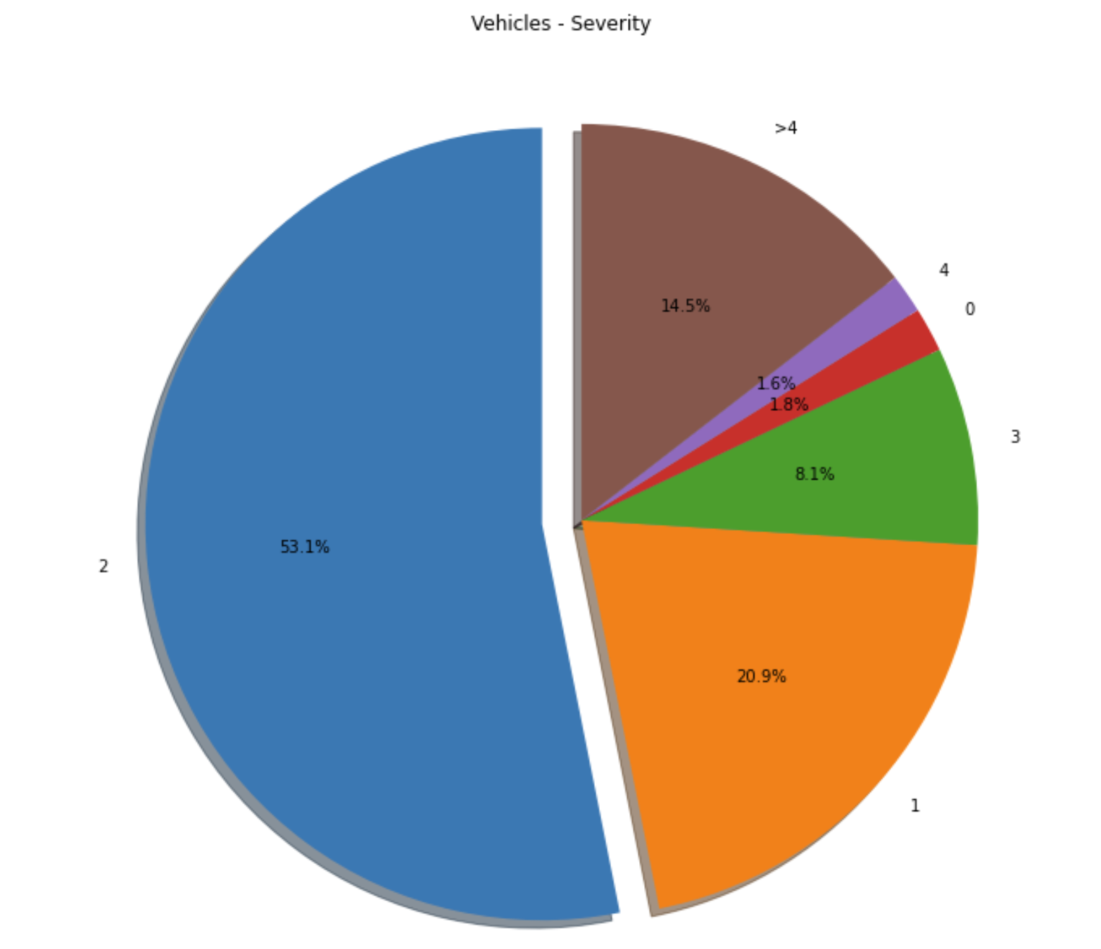
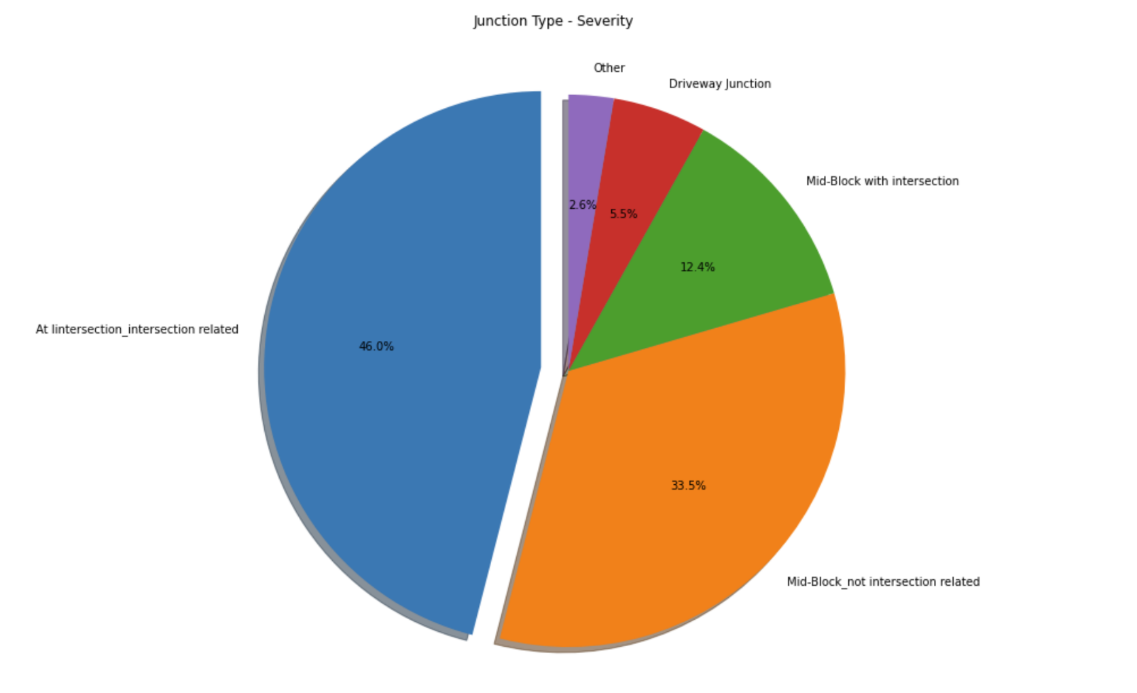

Slide 10
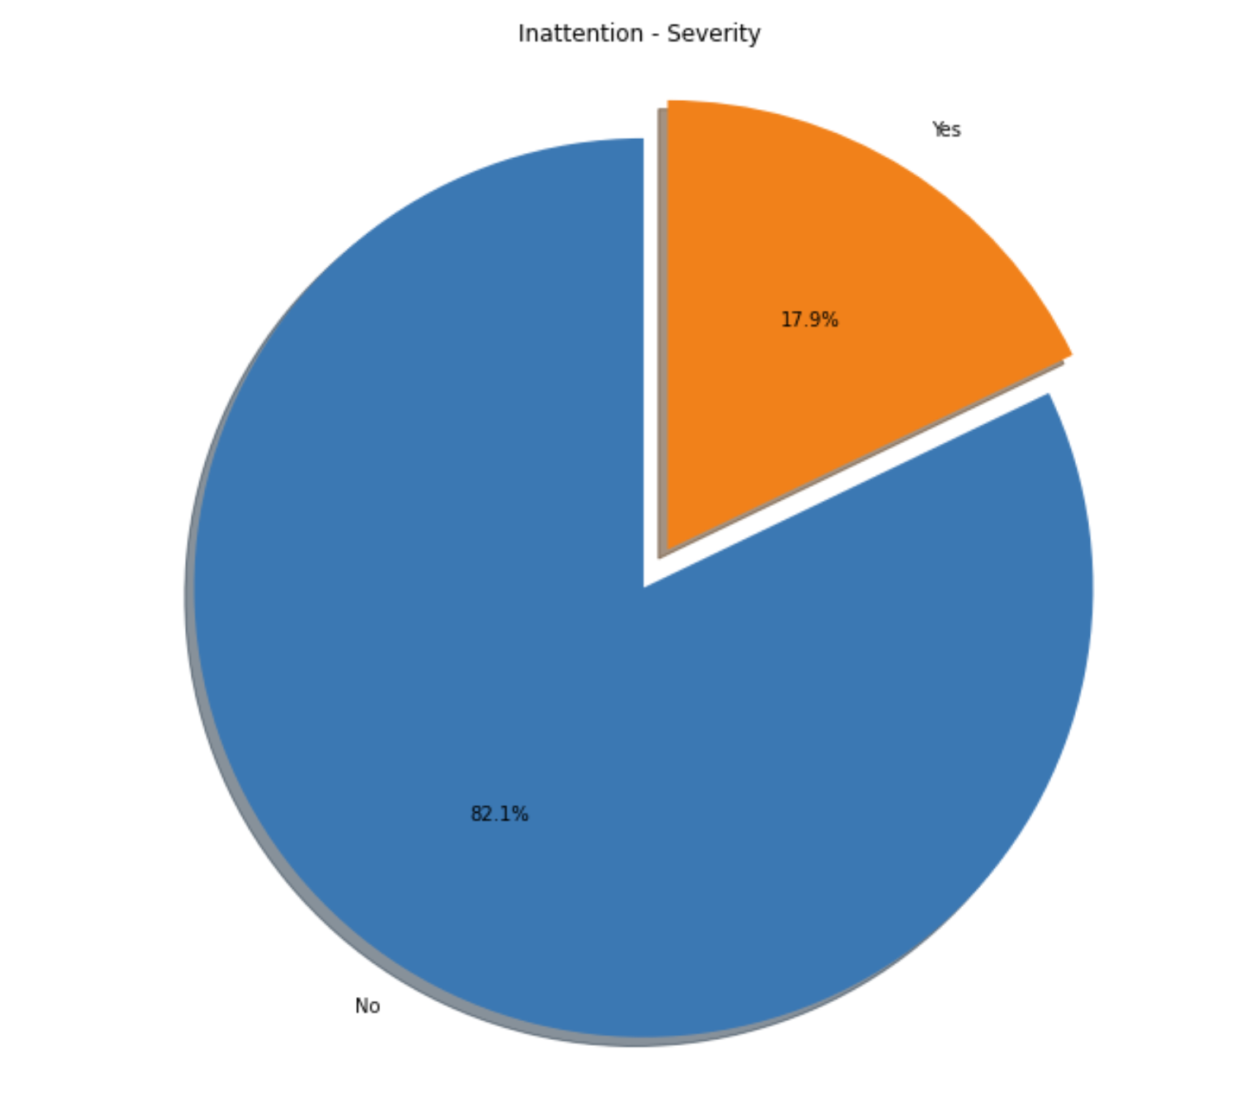
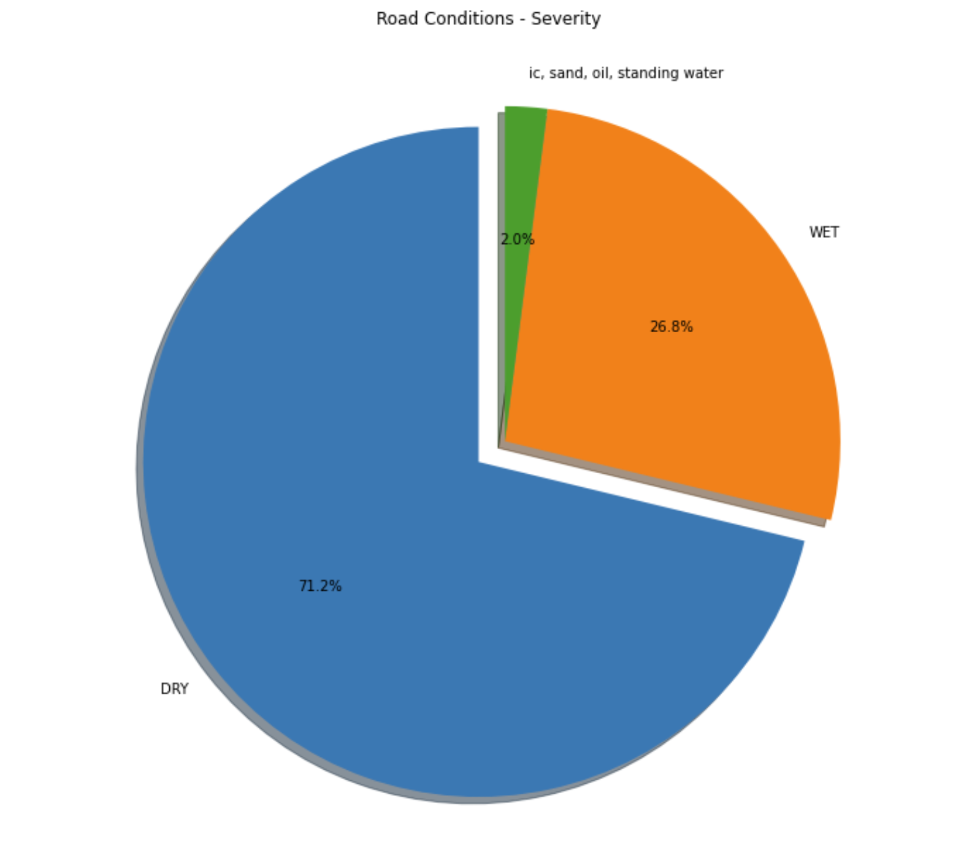

Slide 11
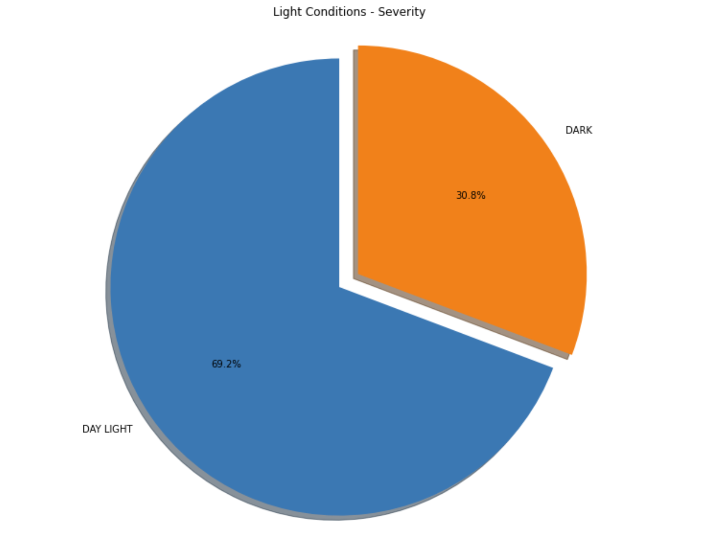
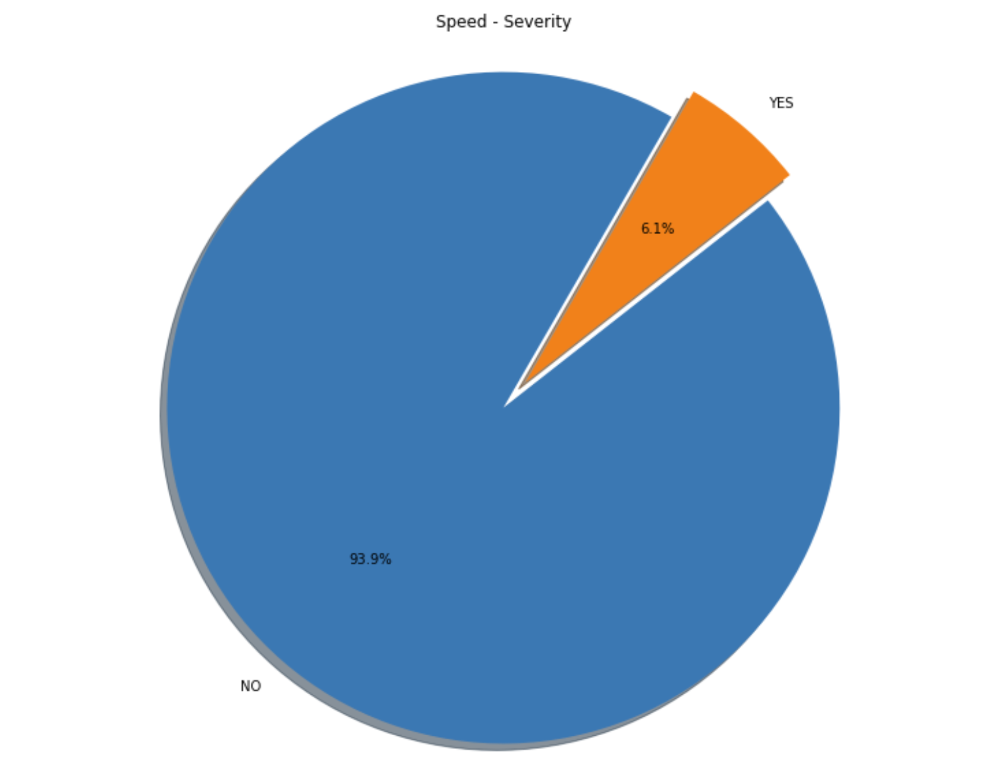

Slide 12
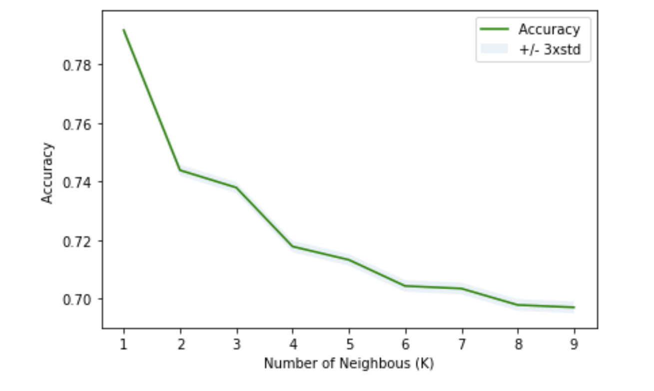
Model development
KNN:
k=1 was selected from
the table

Slide 13
Decision Tree
Logistic Regression
Decision Tree

Slide 14
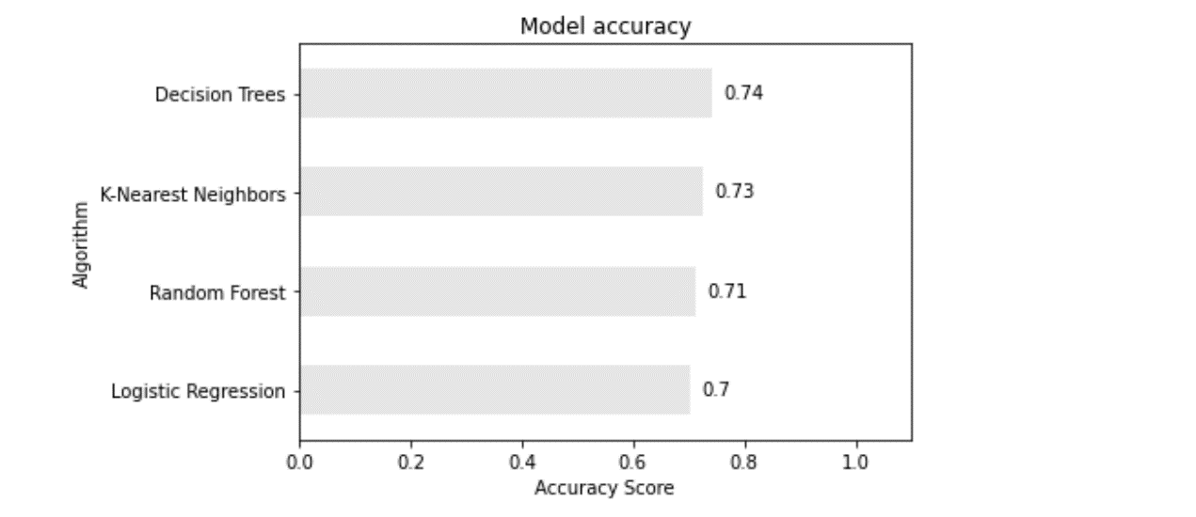
Results
Decision tree won the highest accuracy score with 0.74l among all model been tested in the prediction of car accident severity, followed by the K-NN (0.73), random forest (0.71) and logistic regression (0.7)

Slide 15
Recommendation
The accuracy scores of the four methods used in our test are very close. The score range [0.7, 0.74] indicates that our model neither did an excellent job nor a very bad job. In other words, we can even increase our prediction accuracy to over 80% by further amendment. In our case, missing values occupy a lot, so they might have affected our accuracy.
Future work will be feeding more data into the dataset to increase model accuracy. In our case, age was not considered but it could impact on driving and car accident.

Slide 16
Thanks for watching

